Slide 1
Solution overview
Vedicis +PortaOne integration
DRAFT

Slide 2

Agenda
This presentation describes the solution proposed by Vedicis to build a common solution with PortaOne for Advanced Data charging enablement.
Solution overview
Functional description
Architecture
Conclusion
www.vedicis.com

Slide 3






Solution scope - Value Proposition
Vedicis provides the DPI-PCEF, integrated with PortaOne OCS
For advanced data charging
MVNO Data Center -Cloud
Mobile Access Network
BRAS
PORTAONE
Charging / Billing
Data Traffic
Subscribers
Mobile Access Network
GGSN
Gi
Content Smart Switch
Internet
Advanced
Data charging
 Empower MVNO to access to
Data Control
Usage Visibility
Integration and configuration shortcuts
MVNOs: No need for GGSN acquisition
PCRF is not a pre-requisite
Full autonomy to create new services

Slide 4


Two targets: MVNOs, ISPs
MVNO:
MVNO Data Center -Cloud
PORTAONE
Charging / Billing
GGSN
Gi
Content Smart Switch
Subscribers
MNO Network
MVNO
Data Traffic
Internet
ISP:
PORTAONE
Charging / Billing
DSLAMs
etc.
BRAS
Subscribers
Content Smart Switch
Fixed Access network
ISP
Data Traffic
Internet

Slide 5







Monetization Enabler for Advanced Data Charging
Current Charging/ Billing system
Vedicis enables to leverage
the whole feature set
of the charging/billing system
    Multi counters
    Time based charging…
Real time interface
(Gy)
Content Smart Switch
Examples of Data plans supported through Integration with OCS
Data prepaid/postpaid
  Volume and bandwidth on demand
  Traffic redirect to captive portal for refill
Differentiated Applications & Protocols charging
  Zero rating for Facebook, Sponsored data plans
  Specific data packages (Gamers, Video…)
Time of Day based charging
  Facebook free at night, YouTube for 1$ for next hour
5
Notes:
Sponsored Data plans: Volume for Netflix, paid by Netflix

Slide 6











DPI Engine: integrated in the platform
Configurable DPI engine
Streaming Media
YouTube, Netflix, Flash, PPLive, iTunes,
ShoutCast, Spotify, Waze, …
Peer to peer and download sites
BitTorrent, eDonkey, Ares, Gnutella, Xunlei, iMesh, Kugou,…
Market places
Apps Store, Google Market,…
Storage
ftp, rapidshare, dropbox,..
Web browsing
HTTP, HTTPs, Google, Amazon,…
TOP websites depending on region
Social networks
Facebook, Twitter, Linkedin, VK,..
Email
IMAP, POP3, SMTP, Yahoo!Mail, Gmail, …
VoIP and Instant Messaging
Wechat, Jabber, Skype, Gtalk, Facetime,
WhatsApp, Tango, Viber, Line, …
Thousands of Applications and protocols

Slide 7
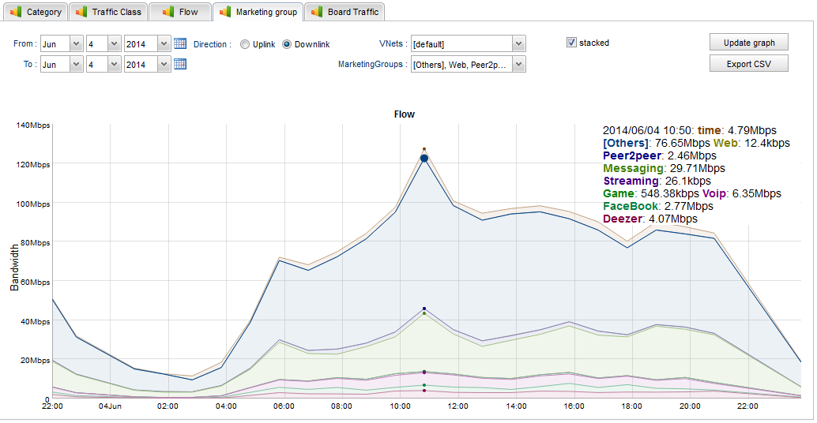
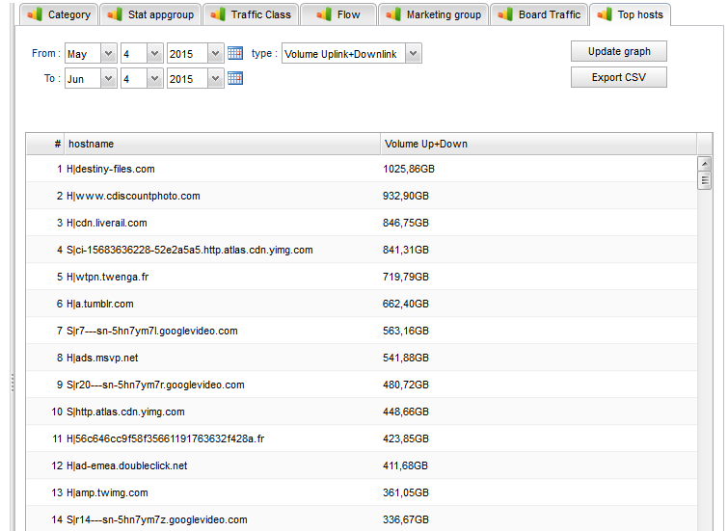
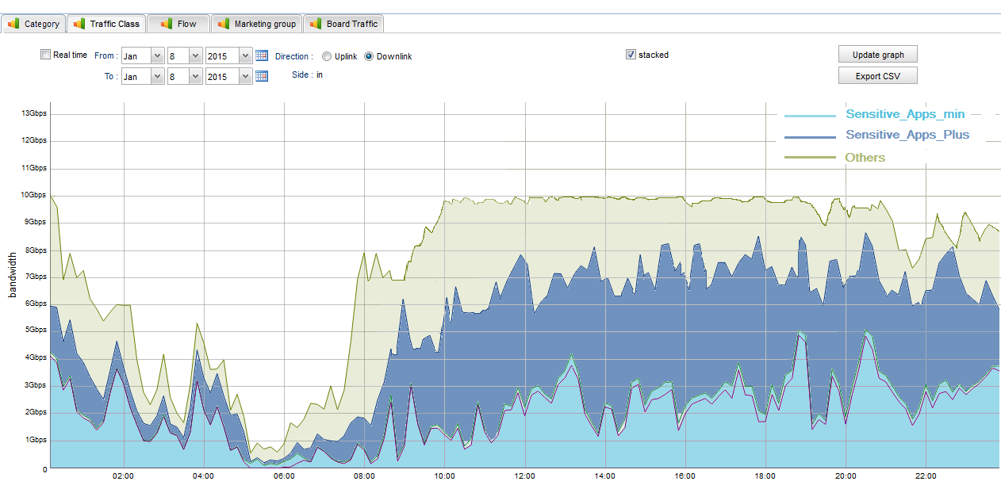
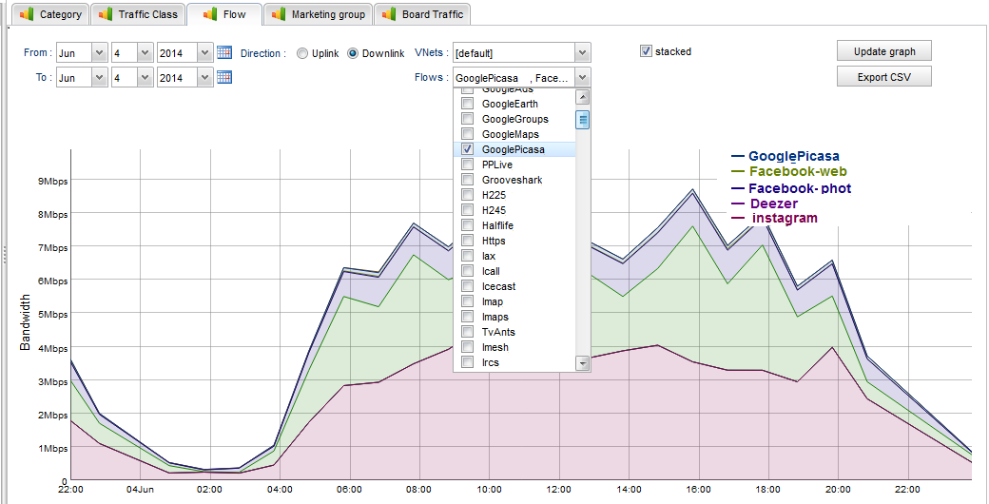
Visibility on Data traffic : Traffic statistics
Application groups
Powered by best of breed DPI
TOP Hostname list
Traffic classes
Applications

Slide 8
Visibility on Data traffic : Data records
Data records generated per subscriber and per period of time (ex. 15 min.)
Can be exported to a third party Reporting Tool
User info
Metrics: Sessions, Volume, KPIs: 300 counters
UserID | Duration | Volume down | Volume Up | Volume 1 | Volume 2 | … | KPI 250
336… | 3915 | 4614683 | 1744698 | 1926831 | 244858 | … | 245
336… | 2361 | 2820605 | 338612 | 851469 | 12793 | … | 230
336… | 3398 | 4014143 | 1082008 | 1113270 | 0 | … | 313
337… | 4317 | 5076704 | 342744 | 1474410 | 2814 | … | 210
337… | 1576 | 18181053 | 1800450 | 154362 | 27865 | … | 161
336… | 2527 | 3000025 | 99017 | 0 | 24065 | … | 540
336… | 1750 | 2010480 | 221153 | 0 | 11107 | … | 497
337… | 539 | 570172 | 28500 | 109400 | 11082 | … | 456
336… | 3772 | 4458340 | 891919 | 0 | 12100 | … | 388
337… | 1781 | 2088368 | 43872 | 384764 | 14179 | … | 382
336… | 4299 | 5148650 | 510040 | 1076193 | 0 | … | 421
Nb users

Slide 9
Architecture overview : MVNO case (Uff Movil)
Traffic routing
Internet Traffic is routed by the HNO to Uff Movil data center.
User awareness and accounting
The exact call flow is defined with PortaOne.
User awareness (mapping between user ID and IP address) is provided in real time by PortaOne.
User accounting is supported through Gy interface.
Customer Portal (optional)
Top-up, credit refill
UFF MOVIL
PORTAONE
Radius
Radiusand Gy
Customer
portal
PDN GW
GGSN
Gi
MVNO Data Traffic
Subscribers
MNO Network
Internet
Other traffic

Slide 10
Call flow “Facebook for free” – scenario 1
Example: “Facebook for free”
To be discussed with PortaOne
(1) The user connects to the network.
(2) PDP context is established by the PDN GW/GGSN,
AccountingStart is sent by the Radius server.
The Vedicis platform analyses this radius message
to get the user identity.
(3) Charging control is supported by a Gy integration
between Vedicis and PortaOne OCS. (Multiple rating
groups, for example: one rating group for “Facebook”,
another rating group for “Others”.
PortaOne
OCS
Radius
(3)
(2)
(1)
PDN GW
GGSN
MVNO Data Traffic
Subscribers
MNO Network
Internet
(*) Call flow can be adapted depending on configuration

Slide 11
Call flow “Facebook for free” – scenario 2
Example: “Facebook for free”
To be discussed with PortaOne
(1) The user connects to the network.
(2) PDP context is established by the PDN GW/GGSN
Radius protocol between GGSN and PortaOne?
PortaOne provides the mapping between user ID and IP (+ activation of Gy rating groups).
Custom message? (Vedicis supports a SOAP API)
(4) Charging control is supported by a Gy integration
between Vedicis and PortaOne OCS. (Multiple rating
groups, for example: one rating group for “Facebook”,
another rating group for “Others”.
PortaOne
OCS
Radius ?
(2)
(3)
(4)
SOAP?
(1)
PDN GW
GGSN
MVNO Data Traffic
Subscribers
MNO Network
Internet
(*) Call flow can be adapted depending on configuration

Slide 12
Vedicis platform - Key technical assets
Software on Standard Hardware
  HP or IBM
  Following NFV trends
  IT solution with linux software
  Performance and scalability
  Only 1 2U server (up to 2 10G links)
  No latency
Integration: 3GPP Compliant
  Standard interfaces between
  Vedicis Platform and OCS
Carrier Grade platform
  Traffic fully secured with Bypass architecture
  Service high availability with redundant platform
  No complex integration
  No interoperability with GGSN, PCRF is not a pre-requisite
  Layer 2 transparency
Software - Scalable - Flexible - Cost effective platform

Slide 13



Conclusion: Key benefits
Enabler for multi-criteria data packages and revenue assurance
  Visibility on the Data traffic
Fast time to service
  IT solution
  Rapid integration (OCS/Billing/CRM)
Cost Efficiency
 Allow MVNO to take control of his Data traffic

Slide 14
Thank you for your attention cecile.garreau@vedicis.com arnaud.gardin@vedicis.com

